Slide 1


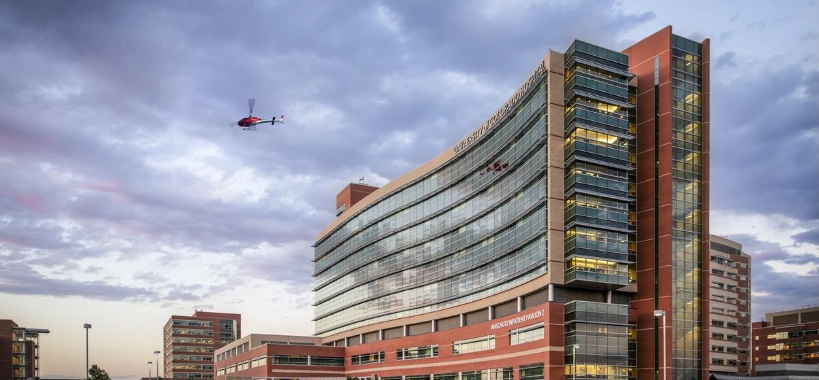
UCHEALTH DIRECT-TO-EMPLOYER PLAN
November 05, 2024

Slide 2



Founded in 1979 and headquartered in Indianapolis, IN​
Full-service TPA specializing in the administration of self-funded health plans and population health management​
One of the country’s largest independently-owned TPAs
The Key Family is a commonly-held group of benefits related organizations with:​
3,000+ corporate clients​
3.0 million members under management​
700 Employees
Exclusive Relationships
We know The Market – Agents, Networks, and MGAs

Slide 3


Market Leader in Private Labeled DTE Plans
Louisville, KY
OneHealth Plan
Cincinnati, OH
TCH Optimal
Bentonville, AR
Northwest Health Plan
Knoxville, TN
East Tennessee Health Plan
Meridian, MS
Affinity Health Plan
Fort Myers, FL
Lee Health Care Partners

Slide 4

Direct-to-Employer (DTE) Your Health Plan Focused on a Direct Relationship with Self-Funded Employers in Your Market
YOU Pick the Name of the Health Plan
YOU Determine the Fees Charged
YOU Practice the Medicine
YOU Receive the Profits
WE Make it Successful

Slide 5

DTE Keys to Success for UCHealth
1
2
DTE Plan Sells
DTE plans only work when the network is built around a strong brand with good access and competitive costs.
UCHealth a quality and the access leader in Central Colorado. Market size is excellent.
Estimates for Margin and Steerage Hold
KBA models high, medium and low estimates for net income based on (1) estimates of commercial margin and (2) the within-DTE-network steerage rate.
Profit growth will hold if these assumptions accurately play out as expected for UCHealth.

Slide 6
Every $1 of Care
Government Pay
Commercial Pay
Results in
~$1.13 of loss
Generates
~$0.42 of profit
See slide 27 for more details on the calculation of commercial and government-pay net income.

Slide 7

Direct-to-Employer Strategy: Powerful Employer Value
Reduced medical spend through lower unit costs and better integrated care
“At the table” with UCHealth
Aligned financial incentives
Complete transparency for unlimited visibility into health benefit plan expenses and cost drivers
Aggressive stop-loss premiums and policy terms
Increased employee satisfaction
Improved cash flow & stabilization of future medical cost trend

Slide 8
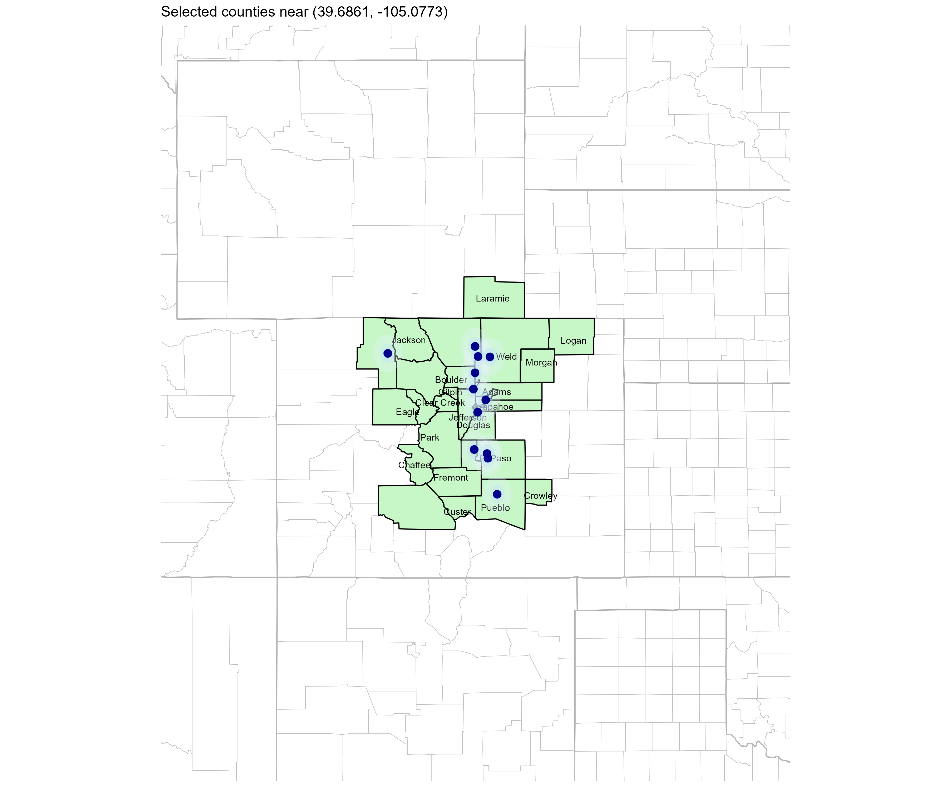
Significant Opportunity for Plan Growth Researched for Central Colorado
Target Market 8,000+ Employers 1,500,000+ Employees 2,400,000+ Members
 | Employer Size Group (# of Employees)
Commercial Employers With Headquarters | 50-100 | 101-200 | 201-400 | 401-1,000 | 1,001-3,000 | 3,000+
In Catchment Area | 911 | 352 | 192 | 141 | 56 | 29
Total Employees at Employers | 50-100 | 101-200 | 201-400 | 401-1,000 | 1,001-3,000 | 3,000+
Headquartered in Catchment Area | 349,200 | 293,400 | 352,800 | 455,700 | 424,000 | 786,000
Total Members with Employers | 50-100 | 101-200 | 201-400 | 401-1,000 | 1,001-3,000 | 3,000+
Headquartered in Catchment Area | 628,600 | 528,100 | 635,000 | 820,300 | 763,200 | 1,414,800
Estimates include Adams, Alamosa, Arapahoe, Archuleta, Baca, Bent, Boulder, Chaffee, Cheyenne, Clear Creek, Crowley, Custer, Denver, Douglas, Eagle, El Paso, Fremont, Garfield, Gilpin, Grand, Huerfano, Jackson, Jefferson, Kiowa, Larimer, Las Animas, Logan, Moffat, Morgan, Otero, Park, Phillips, Prowers, Pueblo, Rio Grande, Routt, Saguache, Sedgwick, Summit, Teller, Weld, Yuma, Box Butte, Scotts Bluff, Colfax, Albany, Carbon, Goshen, Laramie, and Platte Counties

Slide 9
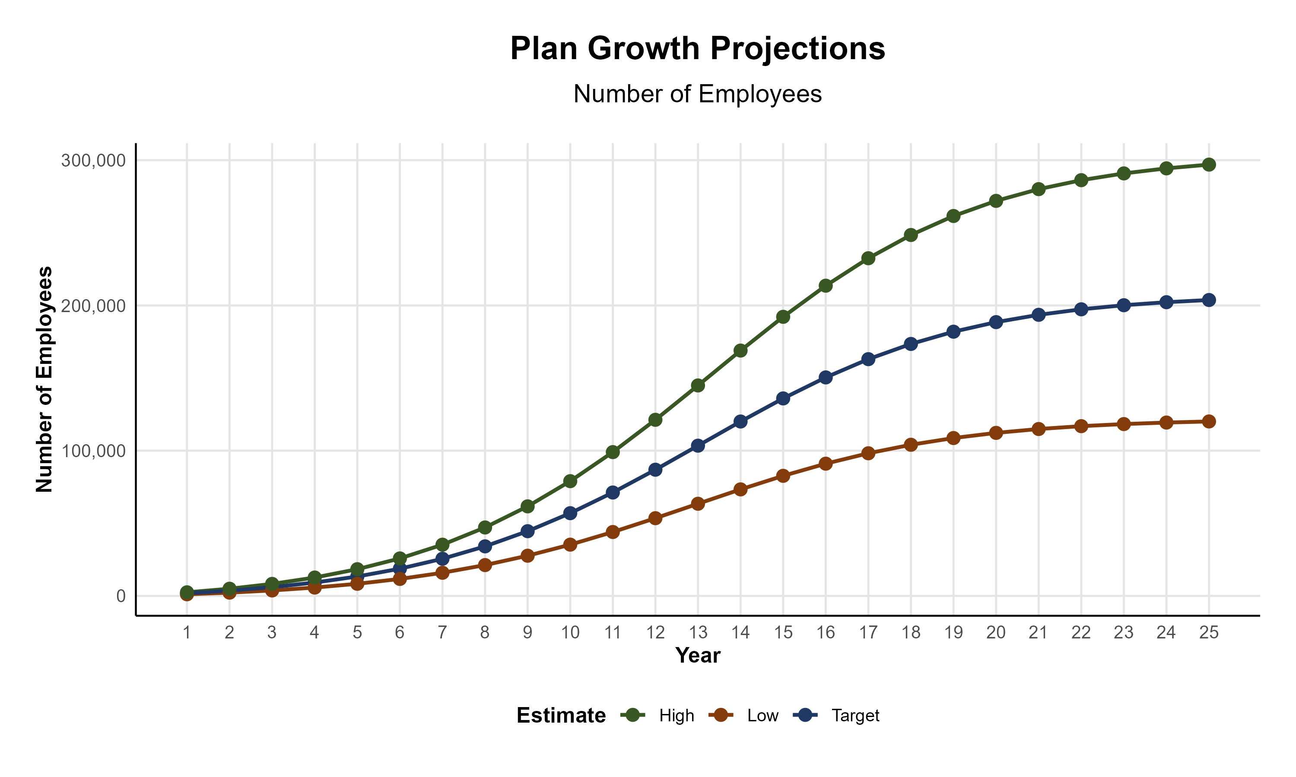
Plan Potential Growth Paths
Self Funded
1,351K
PLAN GROWTH POTENTIAL
2,395K
Insured
Working Age
3,364K
Population
5,506K
Estimates include Adams, Alamosa, Arapahoe, Archuleta, Baca, Bent, Boulder, Chaffee, Cheyenne, Clear Creek, Crowley, Custer, Denver, Douglas, Eagle, El Paso, Fremont, Garfield, Gilpin, Grand, Huerfano, Jackson, Jefferson, Kiowa, Larimer, Las Animas, Logan, Moffat, Morgan, Otero, Park, Phillips, Prowers, Pueblo, Rio Grande, Routt, Saguache, Sedgwick, Summit, Teller, Weld, Yuma, Box Butte, Scotts Bluff, Colfax, Albany, Carbon, Goshen, Laramie, and Platte Counties

Slide 10

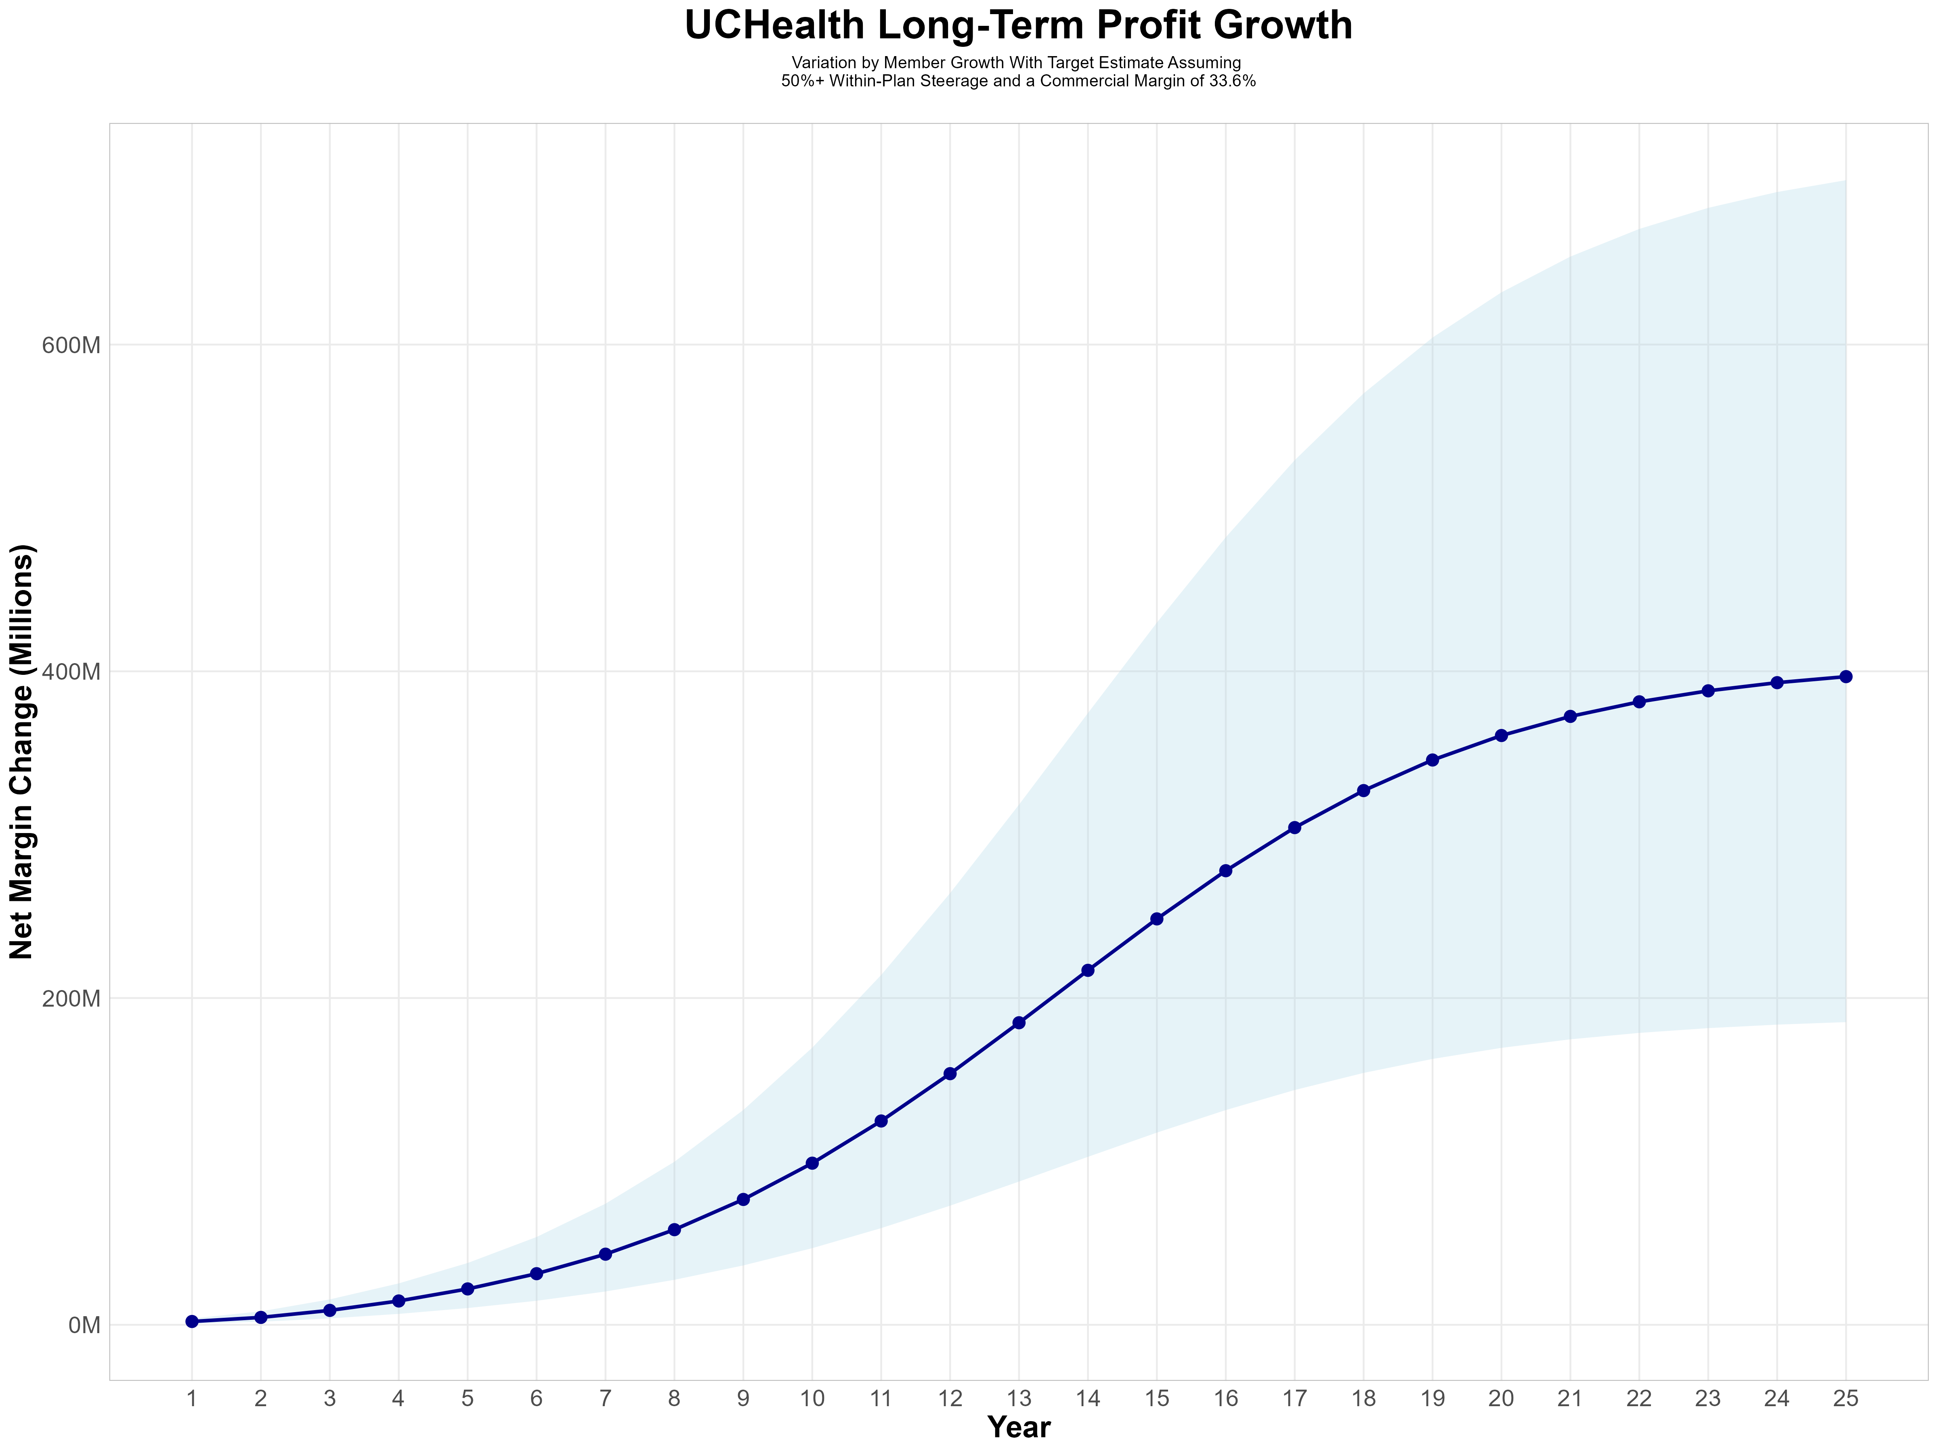
Growing Powerful, Lasting Profitability
Early Stage
Gaining Name Recognition, Early Growth
New Revenue:
New Profit:
$68.28M
$23.08M
Growth Stage
Strong Reputation, Strong Growth
New Revenue:
New Profit:
$507.93M
$172.79M
Mature Stage
High Profitability, Market Saturation
New Revenue:
New Profit:
$1068.13M
$363.25M

Slide 11
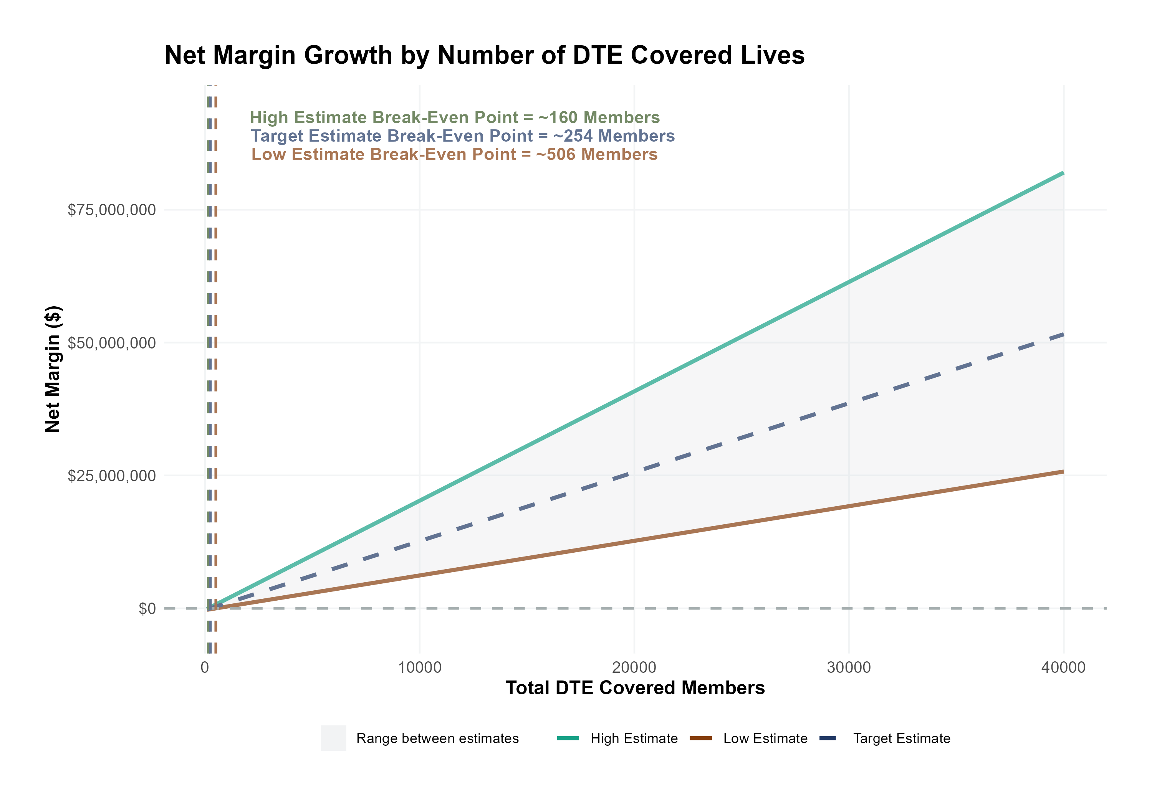
Estimated Financial Returns and Assumptions
Patient Steerage Assumptions
KBA currently estimates that UCHealth has 28% inpatient market share, and 17% outpatient market compared to hospitals/clinics in the Central Colorado. The DTE tiered structure will create immediate steerage, with additional steerage over time from patient bonus benefits and the patient card (see slide 33 for estimates of target steerage).
SINGLE-YEAR PROJECTION
Low
High
10% below target
10% above target
Commercial Margin Assumptions
KBA observes a UCHealth 42% commercial margin. Conservatively, we model the DTE to be level with commercial rates given prices 10% below market, but with a 10 percentage-point increase through friendlier billing practices and improved patient collections with the patient card.
Low
Target
High
28.6%
33.6%
38.6%

Slide 12
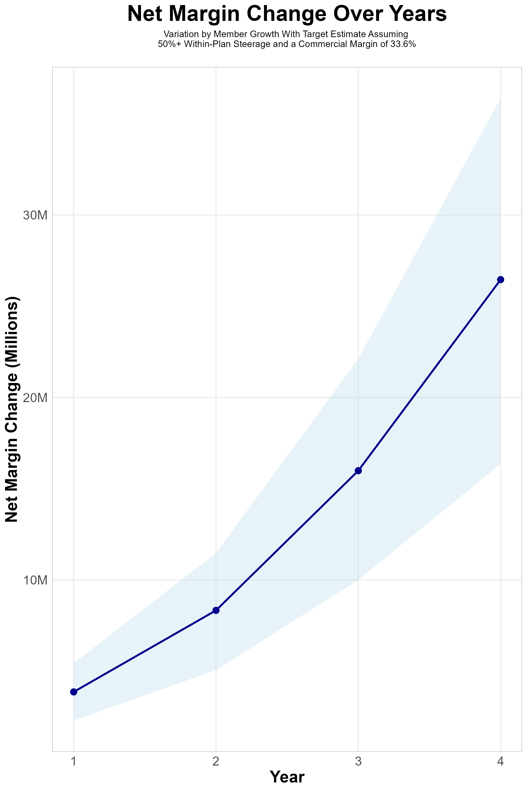
FOUR-YEAR PROJECTIONS
Target Member Growth | Target Member Growth | Target Member Growth | Target Member Growth | Target Member Growth
Metric | Year 1 | Year 2 | Year 3 | Year 4
Number of Members | 3,200 | 6,500 | 10,800 | 16,600
Incremental Margin | 4,152.1K | 8,430.2K | 16,035.8K | 26,439.1K
Network Access Fee | 38.4K | 78.0K | 129.6K | 199.2K
Implementation Fee (One-Time) | -150.0K | 0.0K | 0.0K | 0.0K
Sales and Marketing Costs | -180.0K | -180.0K | -180.0K | -180.0K
Net Margin Change | 3,860.5K | 8,328.2K | 15,985.4K | 26,458.3K
High Member Growth | High Member Growth | High Member Growth | High Member Growth | High Member Growth
Metric | Year 1 | Year 2 | Year 3 | Year 4
Number of Members | 4,400 | 8,900 | 14,900 | 22,800
Incremental Margin | 5,709.2K | 11,542.9K | 22,123.5K | 36,314.0K
Network Access Fee | 52.8K | 106.8K | 178.8K | 273.6K
Implementation Fee (One-Time) | -150.0K | 0.0K | 0.0K | 0.0K
Sales and Marketing Costs | -180.0K | -180.0K | -180.0K | -180.0K
Net Margin Change | 5,432.0K | 11,469.7K | 22,122.3K | 36,407.6K
Low Member Growth | Low Member Growth | Low Member Growth | Low Member Growth | Low Member Growth
Metric | Year 1 | Year 2 | Year 3 | Year 4
Number of Members | 2,000 | 4,000 | 6,800 | 10,300
Incremental Margin | 2,595.1K | 5,187.8K | 10,096.6K | 16,405.0K
Network Access Fee | 24.0K | 48.0K | 81.6K | 123.6K
Implementation Fee (One-Time) | -150.0K | 0.0K | 0.0K | 0.0K
Sales and Marketing Costs | -180.0K | -180.0K | -180.0K | -180.0K
Net Margin Change | 2,289.1K | 5,055.8K | 9,998.2K | 16,348.6K

Slide 13
Direct-to-Employer Strategy: Only Available to Premier Health Systems
STRONG Brand Quality
EXTENSIVE Patient Access
AFFORDABLE Value Pricing
EXCELLENT Care Quality

Slide 14
UCHealth is Patient Recommended
Health System | HCAHPS Recommendation Percentile | CMS Stars Percentile | Mortality Percentile | Readmission Percentile | KBA Brand Quality Score
Boulder Community Health | 84 | 61 | 69 | 70 | 74
Intermountain Health | 76 | 89 | 57 | 82 | 70
AdventHealth | 71 | 93 | 61 | 74 | 69
UCHealth | 70 | 87 | 68 | 84 | 68
CommonSpirit Health | 61 | 89 | 67 | 78 | 66
Other Independent Hospitals | 61 | 100 | 67 | 68 | 65
Banner Health | 51 | 78 | 60 | 73 | 63
HCA Healthcare | 46 | 82 | 76 | 68 | 60
Denver Health | 37 | 31 | 57 | 64 | 58
Cheyenne Regional Health System | 37 | 87 | 66 | 83 | 57
Regional West Health Services | 1 | 10 | 48 | 56 | 45
Based on quality measures and HCAHPS feedback, KBA estimates that in addition to strong market access, UC Health is a quality brand leader.

Slide 15
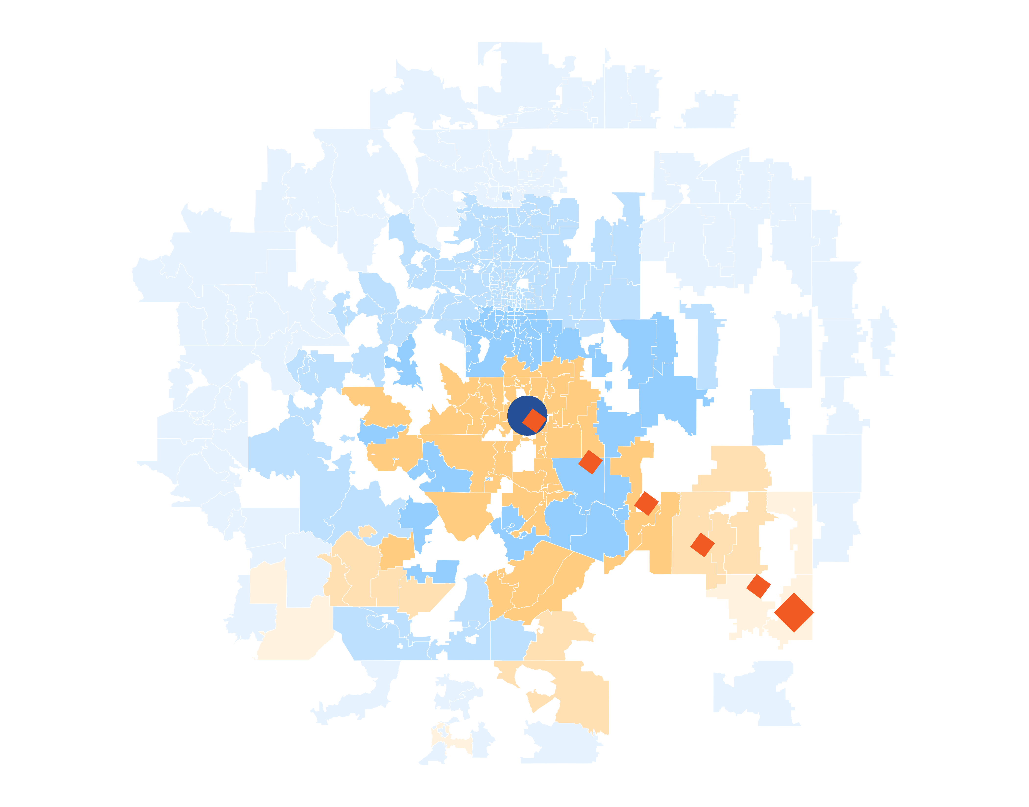
Patients Pass Other Hospitals to Come to UCHealth
KBA models Medicare patient encounter data to identify strong health system brands where patients will travel past other hospitals or long distances to frequent a specific hospital.
The center of the donut are zip codes within which patients have a higher probability of frequenting . These zip codes are ignored for this analysis.
Significant patient encounters outside of this center, as seen here, indicate that patients are willing to travel significant distances, passing other hospitals to go to .
14 patients (admissions) traveled 277.8 miles to UCHealth Memorial Hospital Central despite 57 closer hospitals.

Slide 16
UCHealth NETWORK
Out of Network
Friends & Family (Contracted)
Wrap Network (Rented)
UCHealth’s Network
The medical providers in your direct control or part of UCHealth’s integrated delivery system
Potential risk sharing arrangements (e.g. employer stop-loss participation)
Friends & Family Providers – TIER 1
Access through direct contracts at the discretion of UCHealth
WRAP NETWORK
Medical services from national PPO networks for members that travel, tertiary and specialty services you do not provide, and employees residing outside your direct catchment area
OUT-OF-NETWORK
Non-contracted medical providers

Slide 17

BENEFIT PLAN DESIGNS THAT OPTIMIZE STEERAGE TO UCHEALTH
Exclusive Provider Organization (EPO) Plan Design Structure

Slide 18
SINGLE YEAR SUMMARY
DTE Covered Members Financial Analysis | DTE Covered Members Financial Analysis | DTE Covered Members Financial Analysis | DTE Covered Members Financial Analysis | DTE Covered Members Financial Analysis | DTE Covered Members Financial Analysis | DTE Covered Members Financial Analysis | DTE Covered Members Financial Analysis
Target Estimate Assuming 50%+ Within-Plan Steerage and a Commercial Margin of 33.6%. | Target Estimate Assuming 50%+ Within-Plan Steerage and a Commercial Margin of 33.6%. | Target Estimate Assuming 50%+ Within-Plan Steerage and a Commercial Margin of 33.6%. | Target Estimate Assuming 50%+ Within-Plan Steerage and a Commercial Margin of 33.6%. | Target Estimate Assuming 50%+ Within-Plan Steerage and a Commercial Margin of 33.6%. | Target Estimate Assuming 50%+ Within-Plan Steerage and a Commercial Margin of 33.6%. | Target Estimate Assuming 50%+ Within-Plan Steerage and a Commercial Margin of 33.6%. | Target Estimate Assuming 50%+ Within-Plan Steerage and a Commercial Margin of 33.6%.
DTE Members | Pre-DTE Revenue | Pre-DTE Margin | DTE Revenue | DTE Incr. Revenue | DTE Total Margin | DTE Incr. Margin | Net Margin Less DTE Fees
100 | $ 236K | $ 79K | $ 619K | $ 383K | $ 208K | $ 129K | $ -200K
500 | $ 1,180K | $ 396K | $ 3,093K | $ 1,913K | $ 1,039K | $ 643K | $ 319K
1,000 | $ 2,359K | $ 793K | $ 6,185K | $ 3,826K | $ 2,078K | $ 1,286K | $ 968K
2,500 | $ 5,898K | $ 1,982K | $ 15,463K | $ 9,565K | $ 5,195K | $ 3,214K | $ 2,914K
10,000 | $23,590K | $ 7,926K | $ 61,850K | $38,260K | $20,782K | $12,855K | $12,645K
20,000 | $47,181K | $15,853K | $123,700K | $76,520K | $41,563K | $25,711K | $25,621K
NOTE: Please see detailed financial analysis and assumptions used starting on page 26.
Financial projections do not include 340B contribution margin, which could represent $136 PMPM by optimizing 340B through Rx plan design, UCHealth’s approved site(s) with network integration, and development of UCHealth’s proprietary PBM program.

Slide 19

the missing piece to population health success
Patient engagement is the failure point of population health efforts. Direct employer participation and UCHealth’s clinical leadership is key to driving patient engagement.
KBA’s DTE strategy positions UCHealth to grow commercial market share by reducing per-employee plan costs even further at a time when employers are desperate for a path to better value.
UCHealth can demonstrate greater completion rates for Standards of Care for the Chronically Ill, driving better care & cost outcomes.
Adding UCHealth’s managed care processes to KBA’s patented care management programs will turbocharge results – Positioning UCHealth as a transformational population health leader.
UCHealth CAN PROMOTE THESE RESULTS FROM DAY ONE!!

Slide 20

CHRONIC CONDITION | MINIMUM ANNUAL CARE RECOMMENDED
ASTHMA | 2 Clinical Evaluations 1 Spirometry (for patients 10 years of age or older)
ATRIAL FIBRILLATION | 1 Clinical Evaluation
CHRONIC OBSTRUCTIVE PULMONARY DISEASE | 1 Clinical Evaluation 1 Spirometry
CHRONIC VENOUS THROMBOTIC DISEASE previously listed as Thrombo-embolic Disease | 1 Clinical Evaluation
COPD WITH PULMONARY HYPERTENSION/COR PULMONALE | 2 Clinical Evaluations 12 months of supplemental 02 Tx
CHRONIC KIDNEY DISEASE | 1 Clinical Evaluation 1 Hgb or Hcrt | 1 Serum Creatinine 1 Serum Potassium | 1 Serum Calcium 1 Serum Phosphorus
CONGESTIVE HEART FAILURE | 1 Clinical Evaluation | 1 Serum Creatinine | 1 Serum Potassium
CORONARY ARTERY DISEASE | 1 Clinical Evaluation | 1 LDL
DEPRESSION | 1 Clinical Evaluation
DIABETES | 2 Clinical Evaluations 2 Glycohemoglobins 1 Serum Creatinine | 1 Lipid Panel IF no nephropathy Dx or ACE/ARB Rx, 1 Urine Albumin/Creatinine ratio, Total Protein
EPILEPSY | 1 Clinical Evaluation
HUMAN IMMUNODEFICIENCY VIRUS INFECTION | 2 Clinical Evaluations 2CBCs I T-Cell/CD-4 Count | 2 HIV Quantifications 1 Pap Smear (for women only, 21 years of age or older)
Hyperlipidemia | 1 Lipid Panel
HYPERTENSION | 1 Clinical Evaluation | 1 Serum Creatinine
HYPERTHYROIDISM | 1 Clinical Evaluation | 1 TSH | 1 T4
HYPOTHYROIDISM | 1 Clinical Evaluation | 1 TSH
METABOLIC SYNDROME | 1 Clinical Evaluation | 1 Lipid Panel | 1 FBS or HgbA1c
MULTIPLE SCLEROSIS | 1 Clinical Evaluation
PARKINSON'S DISEASE | 1 Clinical Evaluation
PERIPHERAL ARTERIAL DISEASE (ATHEROSCLEROSIS] previously listed as Peripheral Vascular Disease | 1 Clinical Evaluation 1 LDL
PRE-DIABETES | 1 Clinical Evaluation | 1 Lipid Panel | 1 FBS or HgbA1c
POLYMYALGIA RHEUMATICA | 2 Clinical Evaluation | 2 ESR or CRP | 1 CBC
PULMONARY HYPERTENSION (UNRELATED TO COPD) | 2 Clinical Evaluation
REGIONAL ENTERITIS (INFLAMMATORY BOWEL DISEASE) | 1 Clinical Evaluation
RHEUMATOID ARTHRITIS | 1 Clinical Evaluation
SLEEP APNEA | 1 Clinical Evaluation
ULCERATIVE COLITIS (INFLAMMATORY BOWEL DISEASE) | 1 Clinical Evaluation
INTEGRATION WITH EPIC EHR SYSTEM
CHRONIC DISEASE MANAGEMENT
The chronic diseases identified include a list of services (i.e. exams, lab work and diagnostics) rendered by a network provider payable at 100% and not subject to the deductible or copay.
KBA shares evidence-based standards of care for 27 chronic conditions directly into Epic.

Slide 21

Transparent PBM Integration
Support of UCHealth’s retail pharmacy(s)
Optimize UCHealth’s 340B drug pricing program
Allows UCHealth to create its own PBM program if desired
Custom telephone number with personalized scripting and separate call tracking & reporting
Fully customizable member welcome booklet & materials
White labeled formulary document and marketing materials
CUSTOM CLIENT SUPPORT:
Specialized call center capabilities
Fully customizable plan designs
Operational access to the platform
Customized process and functions to promote DTE strategy
CLINICAL FLEXIBILITY:
Full portfolio of custom formulary offerings – with optimized formulary shield
Clinical programs that drive towards overall DTE strategy
Options for additional drug savings by driving members to lower cost alternatives
Flexibility to customize or layer on utilization management programs

Slide 22
STOP-LOSS INSURANCE
Tokio Marine
Nationwide
Berkshire Hathaway
Sun Life
Liberty Mutual
Granular (Google)
Companion Life
Crum & Forster
American Fidelity
RGA
KBA has over 20 stop-loss underwriters and carriers that we work with on core employer sponsored plans and DTE health plans;
KBA performs a comprehensive analysis of each stop-loss partner to approve them for our business;
KBA provides comprehensive pricing and medical service analysis for each DTE health plan to ensure proper pricing;
KBA is also evaluated by the stop-loss markets to be an approved claims payer for them;
KBA provides the administration required of the stop-loss markets:
Bordereau Reporting;
Claim Reporting and Reconciliation;
Evaluation of Networks;
Care Management;
Initial Underwriting;
Negotiation of rates and terms; and
Plan Design Actuarial

Slide 23

DTE PROGRAM MARKETING & SALES
KBA WORKS WITH YOU TO MANAGE & SELL:
Branding & Messaging
Direct & Brokerage Sales Distribution – Focused Sales Representative
Brochures, Web Site, Media, etc.
Stop-Loss/Level Funded Down to 20 EE Lives
Sell Through Established Brokers in Your Service Area

Slide 24

Complete Sales Distribution System
BROKER DEVELOPMENT
DIRECT SALES
SALES ADMINISTRATION
Identification of Key Distribution Agents
Training and Development
Quote Evaluation
Compensation
Identification of Key Targets
Working with UCHealth to Engage Specific Employers
Meet and Greet
Sales Process
Closing
Quote System
Proposal Development
Stop Loss Negotiations
Reporting & Analysis

Slide 25









Complete Marketing System
Customized Branding and Messaging
Customized Brochures
Customized Web Site
Targeted Employer Outreach
Sales System (Social Media, Email, Text, etc.)

Slide 26

FINANCIAL PROJECTIONS & ASSUMPTIONS:

Slide 27
Estimation of UCHealth’s 2022 Payer Mix
Payer Group | Total Inpatient Days | Revenue | Payer Mix
All UCHealth | 626,238 | $6,398,816K | 100%
Medicare | 151,975 | $892,765K | 24%
Medicaid | 133,137 | $641,477K | 22%
Other Government Pay | 0
No-Pay, Charity Care | 40,311 | -$448,239K | 6%
Commercial/Self Pay | 300,815 | $4,855,444K | 47%
Estimating Payer Mix
Medicare, Medicaid, and other government payer mixes are estimated as the percentage of inpatient days for each group divided by total inpatient days.
No-pay and charity care is estimated as the percentage of no-pay/charity care compared to total overall revenue.
Commercial/self pay is assumed to be the rest of the total payer mix share.
Estimating Total Inpatient Days
Total inpatient days for ‘No Pay’ and ‘Commercial’ are estimated to be the payer mix estimates for “No Pay, Charity Care” and “Commercial/Self Pay” multiplied by the total number of inpatient days.
Values in blue are taken from the 2021 Medicare Provider Cost Report (https://data.cms.gov/provider-compliance/cost-report/hospital-provider-cost-report/data)
Values in yellow are taken from Definitive Healthcare data.
Total Medicare patient revenue is reported by CMS in the Medicare Provider Analysis and Review Report (MedPAR)
In other analysis, the outpatient payer mix is assumed to mirror the inpatient payer mix.

Slide 28
Estimation of Margin for Commercial vs. Government Pay
Estimating Commercial Margin
(Calculated through counterfactual of assuming all CMS/Government pay was paying at commercial rates)
Estimating Gov-Pay Margin
(Calculated through counterfactual of assuming all commercial pay was paying at Medicare rate)
Estimated Total Revenue if All Patients Have Commercial Insurance* | $10,688,196K
Total Costs | $6,190,195K
Net Income | $4,498,001K
 | 42%
Estimated Total Revenue if All Patients Have Gov-Pay Insurance* | $3,043,933K
Total Costs | $6,190,195K
Net Income | $ -3,146,261K
 | -103%
Calculated by dividing the current commercial revenue by the current commercial inpatient day payer mix.
Calculated by dividing the current gov-pay revenue by the current gov-pay inpatient day payer mix.

Slide 29
Estimating Market Share
Hospital Name | Number of Beds | Inpatient Total Charges | Outpatient Total Charges | Inpatient Percent of Market Total | Outpatient Percent of Market Total (Assuming 53.7% of Physicians Employed by Hospitals)
UCHealth Poudre Valley Hospital | 218 | $ 724,691.7K | $1,848,112.4K | 2% | 2%
UCHealth Parkview Medical Center | 253 | $1,320,818.8K | $1,751,587.6K | 3% | 2%
UCHealth Memorial Hospital Central | 587 | $2,750,138.6K | $3,435,334.9K | 6% | 3%
UCHealth University of Colorado Hospital | 709 | $5,880,425.8K | $7,009,125.8K | 13% | 7%
UCHealth Yampa Valley Medical Center | 42 | $ 48,957.6K | $ 200,033.5K | <1% | <1%
UCHealth Medical Center of the Rockies | 180 | $1,025,979.3K | $1,010,879.3K | 2% | 1%
UCHealth Longs Peak Hospital | 83 | $ 361,807.2K | $ 685,340.5K | 1% | 1%
UCHealth Broomfield Hospital | 20 | $ 65,835.2K | $ 262,711.3K | <1% | <1%
UCHealth Grandview Hospital | 22 | $ 28,302.9K | $ 281,079.2K | <1% | <1%
UCHealth Greeley Hospital | 79 | $ 212,294.2K | $ 492,787.7K | <1% | <1%
UCHealth Highlands Ranch Hospital | 87 | $ 471,434.2K | $ 744,147.9K | 1% | 1%
UCHealth Pikes Peak Regional Hospital | 13 | $ 5,321.9K | $ 91,974.8K | <1% | <1%
For outpatient market share, it is estimated that only 53.7% of local physicians are employed by area hospitals (Research from the Physician Advocacy Institute: https://www.physiciansadvocacyinstitute.org/Portals/0/assets/docs/PAI-Research/PAI-Avalere%20Physician%20Employment%20Trends%20Study%202019-2023%20Final.pdf?ver=uGHF46u1GSeZgYXMKFyYvw%3d%3d)

Slide 30
Competitive Area Hospitals
Hospital Name | Number of Beds | Inpatient Total Charges | Outpatient Total Charges | Inpatient Percent of Market Total | Outpatient Percent of Market Total (Assuming 53.7% of Physicians Employed by Hospitals)
OrthoColorado Hospital | 48 | $ 150,959.1K | $ 300,075.1K | <1% | <1%
AdventHealth Castle Rock | 89 | $ 294,215.2K | $ 593,195.3K | 1% | 1%
Banner Fort Collins Medical Center | 29 | $ 46,710.7K | $ 125,092.5K | <1% | <1%
Weisbrod Memorial County Hospital | 25 | $ 1,796.7K | $ 4,969.8K | <1% | <1%
Rio Grande Hospital | 17 | $ 6,820.0K | $ 48,843.5K | <1% | <1%
East Morgan County Hospital | 25 | $ 8,342.8K | $ 56,821.3K | <1% | <1%
Haxtun Hospital District | 25 | $ 5,019.4K | $ 11,645.5K | <1% | <1%
Melissa Memorial Hospital | 15 | $ 3,199.8K | $ 26,572.0K | <1% | <1%
Wray Community District Hospital | 15 | $ 7,722.8K | $ 52,705.8K | <1% | <1%
Sedgwick County Health Center | 9 | $ 4,722.3K | $ 18,506.4K | <1% | <1%
Southeast Colorado Hospital | 15 | $ 16,933.7K | $ 7,947.5K | <1% | <1%
Estes Park Health | 23 | $ 6,442.5K | $ 94,195.1K | <1% | <1%
Memorial Regional Health | 25 | $ 22,427.3K | $ 105,400.0K | <1% | <1%
Yuma District Hospital | 15 | $ 4,389.4K | $ 29,748.4K | <1% | <1%
Spanish Peaks Regional Health Center | 20 | $ 13,082.4K | $ 32,621.5K | <1% | <1%
Grand River Medical Center | 25 | $ 25,332.3K | $ 172,223.2K | <1% | <1%
Middle Park Health - Kremmling | 24 | $ 8,094.4K | $ 85,417.9K | <1% | <1%
Mt San Rafael Hospital | 25 | $ 12,566.7K | $ 86,025.3K | <1% | <1%
Heart of the Rockies Regional Medical Center | 25 | $ 21,020.8K | $ 278,009.8K | <1% | <1%
Prowers Medical Center | 25 | $ 6,979.6K | $ 57,703.0K | <1% | <1%
Pagosa Springs Medical Center | 11 | $ 4,127.5K | $ 74,916.4K | <1% | <1%
Arkansas Valley Regional Medical Center | 25 | $ 16,108.9K | $ 74,303.1K | <1% | <1%
Keefe Memorial Hospital | 11 | $ 1,215.6K | $ 9,801.1K | <1% | <1%
St Thomas More Hospital | 25 | $ 45,620.5K | $ 240,905.1K | <1% | <1%
Childrens Hospital Colorado - Anschutz Medical Campus | 513 | $2,273,209.2K | $1,848,414.9K | 5% | 2%
Childrens Hospital Colorado - Colorado Springs | 117 | $ 432,459.2K | $ 394,439.5K | 1% | <1%
Regional West Medical Center | 122 | $ 301,959.3K | $ 412,962.7K | 1% | <1%
Sidney Regional Medical Center | 19 | $ 15,602.5K | $ 103,977.3K | <1% | <1%
Box Butte General Hospital | 25 | $ 17,916.1K | $ 76,220.3K | <1% | <1%
Miners Colfax Medical Center | 25 | $ 14,626.6K | $ 41,247.7K | <1% | <1%
Cheyenne Regional Medical Center - West Campus | 199 | $ 435,862.8K | $ 607,299.0K | 1% | 1%
Ivinson Memorial Hospital | 76 | $ 50,082.7K | $ 191,994.9K | <1% | <1%
Platte County Memorial Hospital | 25 | $ 5,643.8K | $ 32,870.6K | <1% | <1%
Community Hospital | 25 | $ 11,020.1K | $ 55,971.5K | <1% | <1%
Memorial Hospital of Carbon County | 25 | $ 9,924.9K | $ 50,036.4K | <1% | <1%
For outpatient market share, it is estimated that only 53.7% of local physicians are employed by area hospitals (Research from the Physician Advocacy Institute: https://www.physiciansadvocacyinstitute.org/Portals/0/assets/docs/PAI-Research/PAI-Avalere%20Physician%20Employment%20Trends%20Study%202019-2023%20Final.pdf?ver=uGHF46u1GSeZgYXMKFyYvw%3d%3d)

Slide 31
Competitive Area Hospitals (Continued)
Hospital Name | Number of Beds | Inpatient Total Charges | Outpatient Total Charges | Inpatient Percent of Market Total | Outpatient Percent of Market Total (Assuming 53.7% of Physicians Employed by Hospitals)
Banner North Colorado Medical Center | 182 | $ 448,608.9K | $ 562,163.2K | 1% | 1%
Longmont United Hospital | 127 | $ 163,404.2K | $ 373,526.4K | <1% | <1%
Intermountain Health Platte Valley Hospital | 89 | $ 197,567.5K | $ 479,522.4K | <1% | <1%
SLV Health Regional Medical Center | 49 | $ 50,995.2K | $ 209,096.4K | <1% | <1%
Intermountain Health Lutheran Hospital | 242 | $1,286,834.5K | $1,162,092.9K | 3% | 1%
Denver Health Main Campus | 396 | $1,314,698.5K | $2,150,802.1K | 3% | 2%
St Mary-Corwin Medical Center | 42 | $ 129,866.9K | $ 619,673.9K | <1% | 1%
Presbyterian/St Lukes Medical Center | 287 | $3,254,810.6K | $1,783,658.9K | 7% | 2%
St Anthony Hospital | 220 | $1,566,038.2K | $1,188,821.4K | 3% | 1%
Foothills Hospital | 139 | $ 841,494.1K | $1,257,286.2K | 2% | 1%
Intermountain Health Saint Joseph Hospital | 352 | $1,666,957.3K | $1,516,265.1K | 4% | 1%
Banner McKee Medical Center | 101 | $ 102,874.9K | $ 233,008.1K | <1% | <1%
Penrose Hospital | 601 | $2,204,662.1K | $2,318,850.0K | 5% | 2%
Rose Medical Center | 231 | $1,362,998.5K | $1,958,106.1K | 3% | 2%
Swedish Medical Center | 304 | $4,383,622.3K | $2,539,153.9K | 9% | 2%
St Elizabeth Hospital | 31 | $ 35,482.2K | $ 94,143.4K | <1% | <1%
AdventHealth Porter | 180 | $ 747,613.1K | $ 919,954.8K | 2% | 1%
North Suburban Medical Center | 139 | $1,177,278.5K | $1,511,442.6K | 3% | 1%
Valley View Hospital | 31 | $ 208,588.4K | $ 560,145.8K | <1% | 1%
Sterling Regional MedCenter | 25 | $ 18,776.7K | $ 102,341.8K | <1% | <1%
Vail Health | 54 | $ 108,275.5K | $ 379,989.3K | <1% | <1%
The Medical Center of Aurora | 326 | $2,806,753.0K | $2,135,593.3K | 6% | 2%
AdventHealth Avista | 108 | $ 265,028.8K | $ 612,330.6K | 1% | 1%
National Jewish Health | 13 | $ 2,178.4K | $ 263,553.1K | <1% | <1%
Sky Ridge Medical Center | 284 | $2,764,256.4K | $2,753,036.1K | 6% | 3%
Advent Health Littleton | 201 | $ 842,396.9K | $ 928,638.1K | 2% | 1%
AdventHealth Parker | 162 | $ 742,583.7K | $1,077,997.7K | 2% | 1%
Intermountain Health Good Samaritan Hospital | 183 | $ 844,149.5K | $1,006,871.0K | 2% | 1%
St Anthony Summit Medical Center | 34 | $ 56,468.1K | $ 278,192.1K | <1% | <1%
For outpatient market share, it is estimated that only 53.7% of local physicians are employed by area hospitals (Research from the Physician Advocacy Institute: https://www.physiciansadvocacyinstitute.org/Portals/0/assets/docs/PAI-Research/PAI-Avalere%20Physician%20Employment%20Trends%20Study%202019-2023%20Final.pdf?ver=uGHF46u1GSeZgYXMKFyYvw%3d%3d)

Slide 32
Metric | UCHealth Poudre Valley Hospital | UCHealth Parkview Medical Center | UCHealth Memorial Hospital Central | UCHealth University of Colorado Hospital | UCHealth Yampa Valley Medical Center | UCHealth Medical Center of the Rockies | UCHealth Longs Peak Hospital | UCHealth Broomfield Hospital | UCHealth Grandview Hospital | UCHealth Greeley Hospital | UCHealth Highlands Ranch Hospital | UCHealth Pikes Peak Regional Hospital
Total Inpatient Patient Revenue | $203,638K | $224,539K | $495,025K | $1,217,248K | $23,255K | $272,911K | $62,954K | $12,114K | $3,991K | $49,252K | $91,458K | $1,437K
Total Outpatient Patient Revenue | $519,320K | $297,770K | $618,360K | $1,450,889K | $95,016K | $268,894K | $119,249K | $48,339K | $39,632K | $114,327K | $144,365K | $24,833K
Total Medicare Revenue | $105,276K | $68,840K | $157,124K | $355,360K | $17,527K | $97,560K | $21,867K | $6,255K | $7,536K | $22,642K | $29,920K | $2,857K
Estimated Medicaid and Other Government-Pay Revenue | $50,588K | $72,860K | $130,927K | $277,962K | $9,570K | $27,692K | $19,471K | $4,671K | $5,314K | $20,545K | $15,661K | $6,217K
Estimated Commercial Revenue | $566,522K | $381,199K | $824,363K | $2,028,663K | $91,178K | $415,826K | $140,421K | $49,376K | $30,640K | $120,390K | $189,636K | $17,232K
Total Uncompensated Care | $53,829K | $10,916K | $104,264K | $187,083K | $3,618K | $36,782K | $12,551K | $8,391K | $5,601K | $16,068K | $8,441K | $693K
Estimated Inpatient Costs | $181,598K | $215,618K | $477,180K | $1,192,537K | $24,509K | $240,864K | $63,875K | $13,105K | $4,502K | $54,046K | $95,460K | $1,572K
Estimated Outpatient Costs | $463,111K | $285,939K | $596,069K | $1,421,435K | $100,139K | $237,319K | $120,993K | $52,296K | $44,714K | $125,453K | $150,682K | $27,176K
Total Operating Expenses | $644,709K | $501,557K | $1,073,249K | $2,613,973K | $124,648K | $478,184K | $184,868K | $65,402K | $49,217K | $179,499K | $246,142K | $28,749K
Net Income | $77,676K | $21,343K | $39,165K | $48,012K | $-6,373K | $62,894K | $-3,108K | $-5,099K | $-5,727K | $-15,922K | $-10,925K | $-2,443K
Estimated Commercial Profit Margin | 46.8% | 5.5% | 46.9% | 41.7% | 33.4% | 45.0% | 36.3% | 82.1% | 39.3% | 35.4% | 27.6% | 14.9%
1. Most data is taken from the CMS provider cost report | 1. Most data is taken from the CMS provider cost report | 1. Most data is taken from the CMS provider cost report | 1. Most data is taken from the CMS provider cost report | 1. Most data is taken from the CMS provider cost report | 1. Most data is taken from the CMS provider cost report | 1. Most data is taken from the CMS provider cost report | 1. Most data is taken from the CMS provider cost report | 1. Most data is taken from the CMS provider cost report | 1. Most data is taken from the CMS provider cost report | 1. Most data is taken from the CMS provider cost report | 1. Most data is taken from the CMS provider cost report | 1. Most data is taken from the CMS provider cost report
2. Medicare costs are taken from the Medicare Provider Analysis and Review (MedPAR) | 2. Medicare costs are taken from the Medicare Provider Analysis and Review (MedPAR) | 2. Medicare costs are taken from the Medicare Provider Analysis and Review (MedPAR) | 2. Medicare costs are taken from the Medicare Provider Analysis and Review (MedPAR) | 2. Medicare costs are taken from the Medicare Provider Analysis and Review (MedPAR) | 2. Medicare costs are taken from the Medicare Provider Analysis and Review (MedPAR) | 2. Medicare costs are taken from the Medicare Provider Analysis and Review (MedPAR) | 2. Medicare costs are taken from the Medicare Provider Analysis and Review (MedPAR) | 2. Medicare costs are taken from the Medicare Provider Analysis and Review (MedPAR) | 2. Medicare costs are taken from the Medicare Provider Analysis and Review (MedPAR) | 2. Medicare costs are taken from the Medicare Provider Analysis and Review (MedPAR) | 2. Medicare costs are taken from the Medicare Provider Analysis and Review (MedPAR) | 2. Medicare costs are taken from the Medicare Provider Analysis and Review (MedPAR)
3. Data with 'Estimated' in the title are derived from other data points. | 3. Data with 'Estimated' in the title are derived from other data points. | 3. Data with 'Estimated' in the title are derived from other data points. | 3. Data with 'Estimated' in the title are derived from other data points. | 3. Data with 'Estimated' in the title are derived from other data points. | 3. Data with 'Estimated' in the title are derived from other data points. | 3. Data with 'Estimated' in the title are derived from other data points. | 3. Data with 'Estimated' in the title are derived from other data points. | 3. Data with 'Estimated' in the title are derived from other data points. | 3. Data with 'Estimated' in the title are derived from other data points. | 3. Data with 'Estimated' in the title are derived from other data points. | 3. Data with 'Estimated' in the title are derived from other data points. | 3. Data with 'Estimated' in the title are derived from other data points.
4. Market Share estimates based on total patient revenues with area hospitals. Ambulatory market share based on regional estimates of the percentage of local physicians employed by area hospitals. See Physician Advocacy Institute | 4. Market Share estimates based on total patient revenues with area hospitals. Ambulatory market share based on regional estimates of the percentage of local physicians employed by area hospitals. See Physician Advocacy Institute | 4. Market Share estimates based on total patient revenues with area hospitals. Ambulatory market share based on regional estimates of the percentage of local physicians employed by area hospitals. See Physician Advocacy Institute | 4. Market Share estimates based on total patient revenues with area hospitals. Ambulatory market share based on regional estimates of the percentage of local physicians employed by area hospitals. See Physician Advocacy Institute | 4. Market Share estimates based on total patient revenues with area hospitals. Ambulatory market share based on regional estimates of the percentage of local physicians employed by area hospitals. See Physician Advocacy Institute | 4. Market Share estimates based on total patient revenues with area hospitals. Ambulatory market share based on regional estimates of the percentage of local physicians employed by area hospitals. See Physician Advocacy Institute | 4. Market Share estimates based on total patient revenues with area hospitals. Ambulatory market share based on regional estimates of the percentage of local physicians employed by area hospitals. See Physician Advocacy Institute | 4. Market Share estimates based on total patient revenues with area hospitals. Ambulatory market share based on regional estimates of the percentage of local physicians employed by area hospitals. See Physician Advocacy Institute | 4. Market Share estimates based on total patient revenues with area hospitals. Ambulatory market share based on regional estimates of the percentage of local physicians employed by area hospitals. See Physician Advocacy Institute | 4. Market Share estimates based on total patient revenues with area hospitals. Ambulatory market share based on regional estimates of the percentage of local physicians employed by area hospitals. See Physician Advocacy Institute | 4. Market Share estimates based on total patient revenues with area hospitals. Ambulatory market share based on regional estimates of the percentage of local physicians employed by area hospitals. See Physician Advocacy Institute | 4. Market Share estimates based on total patient revenues with area hospitals. Ambulatory market share based on regional estimates of the percentage of local physicians employed by area hospitals. See Physician Advocacy Institute | 4. Market Share estimates based on total patient revenues with area hospitals. Ambulatory market share based on regional estimates of the percentage of local physicians employed by area hospitals. See Physician Advocacy Institute

Slide 33
Estimating PMPY Spend (KBA Data)
Category | Standardized Allowed Charges | Standardized Paid Charges | Member Years | Nationwide Average of Paid Claims | Adjusted to Central Colorado Rates
Inpatient | $ 561,766,609 | $ 358,815,229 | 105,492 | $ 3,401 | $ 3,197
OutPatient | $ 1,223,989,466 | $ 652,333,702 |  | $ 6,184 | $ 5,813
Professional | $ 549,353,224 | $ 304,634,120 |  | $ 2,888 | $ 2,714
KBA utilizes its data warehouse with greater than $3B in yearly adjudicated charges to estimate PMPY spend by inpatient, outpatient and professional charges. Pharmacy and non-health-system charges are excluded.
Using the Milliman area adjustment factors by zip code, charges are standardized to local estimates.
These estimated charges are conservative as KBA claims average ~15% below the market average.

Slide 34
Estimating Expected Steerage (KBA Data)
 | DTE Health Plan Tier 1 Utilization – Q1 2024
 | Charges | % | Paid | % | Discount Equivalent
 |  |  |  |  | Charge to Paid
Tier 1 |  | 81.26%
Current DTE Network #1 | $ 17,913,805.69 | 54.82% | $ 6,907,327.88 | 58.63% | -61.44%
Current DTE Network #2 | $ 8,460,570.40 | 78.37% | $ 3,280,571.45 | 77.62% | -61.23%
Current DTE Network #3 | $ 629,748.27 | 72.98% | $ 198,216.95 | 80.64% | -68.52%
Current DTE Network #4 | $ 58,261,069.02 | 96.15% | $ 12,968,046.77 | 93.20% | -77.74%
 | $ 85,265,193.38 |  | $ 23,354,163.05
DTE Steerage Impact on an EPO Plan Structure
KBA is modeling steerage in line with other observed DTE networks.

Slide 35
Year | Employees | Members | Percent of Members Choosing UCHealth for Inpatient Care | Percent of Members Choosing UCHealth for Outpatient Care
1 | 1,800 | 3,200 | 60% | 50%
2 | 3,600 | 6,500 | 60% | 50%
3 | 6,000 | 10,800 | 65% | 55%
4 | 9,200 | 16,600 | 67% | 58%
5 | 13,400 | 24,100 | 68% | 59%
6 | 18,700 | 33,700 | 68% | 60%
7 | 25,600 | 46,100 | 68% | 60%
8 | 34,100 | 61,400 | 68% | 61%
9 | 44,600 | 80,300 | 69% | 61%
10 | 57,000 | 102,600 | 69% | 62%
11 | 71,200 | 128,200 | 69% | 62%
12 | 86,900 | 156,400 | 69% | 63%
13 | 103,400 | 186,100 | 70% | 63%
14 | 120,100 | 216,200 | 70% | 64%
15 | 136,000 | 244,800 | 70% | 64%
16 | 150,400 | 270,700 | 71% | 65%
17 | 163,000 | 293,400 | 71% | 65%
18 | 173,500 | 312,300 | 71% | 66%
19 | 181,900 | 327,400 | 72% | 66%
20 | 188,500 | 339,300 | 72% | 67%
21 | 193,500 | 348,300 | 72% | 67%
22 | 197,300 | 355,100 | 72% | 67%
23 | 200,100 | 360,200 | 72% | 67%
24 | 202,200 | 364,000 | 72% | 68%
25 | 203,700 | 366,700 | 72% | 68%
KBA currently estimates that UCHealth has 28% inpatient market share, and 17% outpatient market compared to hospitals/clinics in the Central Colorado.
Based on previous DTE experience, KBA expects a significant bump in patient steerage to UCHealth.
Additional steerage will occur from additional steerage patient benefits and the patient card.
High estimates start nearly 10% higher than target with low estimates at 10% lower than target
PROJECTED PLAN GROWTH

Slide 36
Year 4 Projected Revenue and Profit
Pre-DTE Cohort of 16,600 Employees | Inpatient | Outpatient | Professional | Total
Revenue† | $ 14,627,038 | $ 16,723,206 | $ 7,809,595 | $ 39,159,839
Net Income‡ | $ 4,914,685 | $ 5,618,997 | $ 2,624,024 | $ 13,157,706
† Assuming proportional revenues from market shares of 28% (inpatient) and 17% (outpatient)
‡ Conservatively assuming a commercial margin of 33.6% (80% of the estimated commercial margin)
With DTE | Inpatient | Outpatient | Professional | Total
Revenue⁰ | $ 35,546,478 | $ 55,697,918 | $ 26,010,454 | $ 117,254,850
Net Income* | $ 11,943,617 | $ 18,714,500 | $ 8,739,513 | $ 39,397,629
⁰ Assuming 67% inpatient and 58% market steerage based on KBA narrow network DTE experience (see previous slide)
* Conservatively assuming a commercial margin of 33.6%, with a 10 percentage-point reduction to reflect competitive-edge rates and a 10 percentage-point increase due to lower billing costs and higher patient responsibility collections because of the member credit card.
Total Increase in Net Income | $ 26,239,924
Network Access Fee (Revenue) of $1 PMPM | $ 199,200
Total Profit Growth | $ 26,244,724
Minus Implementation Fee (One-Time) | -$ 0
Minus Sales and Marketing (Annual – Ongoing) | -$ 180,000
Total | $ 26,259,124

Slide 37
Target Estimate Assuming 50%+ Within-Plan Steerage and a Commercial Margin of 33.6% | Target Estimate Assuming 50%+ Within-Plan Steerage and a Commercial Margin of 33.6% | Target Estimate Assuming 50%+ Within-Plan Steerage and a Commercial Margin of 33.6% | Target Estimate Assuming 50%+ Within-Plan Steerage and a Commercial Margin of 33.6% | Target Estimate Assuming 50%+ Within-Plan Steerage and a Commercial Margin of 33.6%
All values in thousands of dollars. Modeled With Year 1 Fees and Patient Steerage. | All values in thousands of dollars. Modeled With Year 1 Fees and Patient Steerage. | All values in thousands of dollars. Modeled With Year 1 Fees and Patient Steerage. | All values in thousands of dollars. Modeled With Year 1 Fees and Patient Steerage. | All values in thousands of dollars. Modeled With Year 1 Fees and Patient Steerage.
Metric | 500 DTE Covered Lives | 1000 DTE Covered Lives | 5000 DTE Covered Lives | 25000 DTE Covered Lives
Pre-DTE Group Total Revenue | $1,179.5 | $2,359.0 | $11,795.1 | $58,975.7
Pre-DTE Group Total Margin | $396.3 | $792.6 | $3,963.2 | $19,815.8
DTE Group Total Revenue | $3,092.5 | $6,185.0 | $30,925.1 | $154,625.6
DTE Group Incremental Total Revenue | $1,913.0 | $3,826.0 | $19,130.0 | $95,649.9
Incremental Total Revenue by Member | $3.8 | $3.8 | $3.8 | $3.8
DTE Group Total Margin | $1,039.1 | $2,078.2 | $10,390.8 | $51,954.2
DTE Group Incremental Total Margin | $642.8 | $1,285.5 | $6,427.7 | $32,138.4
Wellness Share | $6.0 | $12.0 | $60.0 | $300.0
Implementation Fee (One-Time) | $150.0 | $150.0 | $150.0 | $150.0
Sales and Marketing Annual Fee | $180.0 | $180.0 | $180.0 | $180.0
Net Margin Less DTE Fees | $318.8 | $967.5 | $6,157.7 | $32,108.4

Slide 38
Target Estimate Assuming 50%+ Within-Plan Steerage and a Commercial Margin of 33.6% | Target Estimate Assuming 50%+ Within-Plan Steerage and a Commercial Margin of 33.6% | Target Estimate Assuming 50%+ Within-Plan Steerage and a Commercial Margin of 33.6% | Target Estimate Assuming 50%+ Within-Plan Steerage and a Commercial Margin of 33.6% | Target Estimate Assuming 50%+ Within-Plan Steerage and a Commercial Margin of 33.6%
All values in thousands of dollars. Modeled With Year 1 Fees and Patient Steerage. | All values in thousands of dollars. Modeled With Year 1 Fees and Patient Steerage. | All values in thousands of dollars. Modeled With Year 1 Fees and Patient Steerage. | All values in thousands of dollars. Modeled With Year 1 Fees and Patient Steerage. | All values in thousands of dollars. Modeled With Year 1 Fees and Patient Steerage.
Metric | 500 DTE Covered Lives | 1000 DTE Covered Lives | 5000 DTE Covered Lives | 25000 DTE Covered Lives
Pre-DTE Group Inpatient Revenue | $440.6 | $881.1 | $4,405.7 | $22,028.7
Pre-DTE Group Inpatient Margin | $148.0 | $296.1 | $1,480.3 | $7,401.6
DTE Group Inpatient Revenue | $959.5 | $1,919.1 | $9,595.3 | $47,976.7
DTE Group Inpatient Margin | $322.4 | $644.8 | $3,224.0 | $16,120.2
DTE Group Incremental Inpatient Revenue | $519.0 | $1,037.9 | $5,189.6 | $25,948.0
DTE Group Incremental Inpatient Margin | $174.4 | $348.7 | $1,743.7 | $8,718.5
Pre-DTE Group Outpatient Revenue | $503.7 | $1,007.4 | $5,037.1 | $25,185.6
Pre-DTE Group Outpatient Margin | $169.2 | $338.5 | $1,692.5 | $8,462.3
DTE Group Outpatient Revenue | $1,454.0 | $2,908.0 | $14,539.8 | $72,699.0
DTE Group Outpatient Margin | $488.5 | $977.1 | $4,885.4 | $24,426.9
DTE Group Incremental Outpatient Revenue | $950.3 | $1,900.5 | $9,502.7 | $47,513.5
DTE Group Incremental Outpatient Margin | $319.3 | $638.6 | $3,192.9 | $15,964.5
Pre-DTE Group Professional Revenue | $235.2 | $470.5 | $2,352.3 | $11,761.4
Pre-DTE Group Professional Margin | $79.0 | $158.1 | $790.4 | $3,951.8
DTE Group Professional Revenue | $679.0 | $1,358.0 | $6,790.0 | $33,949.8
DTE Group Professional Margin | $228.1 | $456.3 | $2,281.4 | $11,407.1
DTE Group Incremental Professional Revenue | $443.8 | $887.5 | $4,437.7 | $22,188.4
DTE Group Incremental Professional Margin | $149.1 | $298.2 | $1,491.1 | $7,455.3
Net Margin Less DTE Fees | $318.8 | $967.5 | $6,157.7 | $32,108.4

Slide 39
High Estimate Assuming 60%+ Within-Plan Steerage and a Commercial Margin of 38.6% | High Estimate Assuming 60%+ Within-Plan Steerage and a Commercial Margin of 38.6% | High Estimate Assuming 60%+ Within-Plan Steerage and a Commercial Margin of 38.6% | High Estimate Assuming 60%+ Within-Plan Steerage and a Commercial Margin of 38.6% | High Estimate Assuming 60%+ Within-Plan Steerage and a Commercial Margin of 38.6%
All values in thousands of dollars. Modeled With Year 1 Fees and Patient Steerage. | All values in thousands of dollars. Modeled With Year 1 Fees and Patient Steerage. | All values in thousands of dollars. Modeled With Year 1 Fees and Patient Steerage. | All values in thousands of dollars. Modeled With Year 1 Fees and Patient Steerage. | All values in thousands of dollars. Modeled With Year 1 Fees and Patient Steerage.
Metric | 500 DTE Covered Lives | 1000 DTE Covered Lives | 5000 DTE Covered Lives | 25000 DTE Covered Lives
Pre-DTE Group Total Revenue | $1,179.5 | $2,359.0 | $11,795.1 | $58,975.7
Pre-DTE Group Total Margin | $396.3 | $792.6 | $3,963.2 | $19,815.8
DTE Group Total Revenue | $3,677.2 | $7,354.4 | $36,771.9 | $183,859.5
DTE Group Incremental Total Revenue | $2,497.7 | $4,995.4 | $24,976.8 | $124,883.8
DTE Group Total Margin | $1,419.4 | $2,838.8 | $14,194.0 | $70,969.8
DTE Group Incremental Total Margin | $1,023.1 | $2,046.2 | $10,230.8 | $51,153.9
Wellness Share | $6.0 | $12.0 | $60.0 | $300.0
Implementation Fee (One-Time) | $150.0 | $150.0 | $150.0 | $150.0
Sales and Marketing Annual Fee | $180.0 | $180.0 | $180.0 | $180.0
Net Margin Less DTE Fees | $699.1 | $1,728.2 | $9,960.8 | $51,123.9

Slide 40
Low Estimate Assuming 40%+ Within-Plan Steerage and a Commercial Margin of 28.6% | Low Estimate Assuming 40%+ Within-Plan Steerage and a Commercial Margin of 28.6% | Low Estimate Assuming 40%+ Within-Plan Steerage and a Commercial Margin of 28.6% | Low Estimate Assuming 40%+ Within-Plan Steerage and a Commercial Margin of 28.6% | Low Estimate Assuming 40%+ Within-Plan Steerage and a Commercial Margin of 28.6%
All values in thousands of dollars. Modeled With Year 1 Fees and Patient Steerage. | All values in thousands of dollars. Modeled With Year 1 Fees and Patient Steerage. | All values in thousands of dollars. Modeled With Year 1 Fees and Patient Steerage. | All values in thousands of dollars. Modeled With Year 1 Fees and Patient Steerage. | All values in thousands of dollars. Modeled With Year 1 Fees and Patient Steerage.
Metric | 500 DTE Covered Lives | 1000 DTE Covered Lives | 5000 DTE Covered Lives | 25000 DTE Covered Lives
Pre-DTE Group Total Revenue | $1,179.5 | $2,359.0 | $11,795.1 | $58,975.7
Pre-DTE Group Total Margin | $396.3 | $792.6 | $3,963.2 | $19,815.8
DTE Group Total Revenue | $2,504.0 | $5,008.0 | $25,039.9 | $125,199.4
DTE Group Incremental Total Revenue | $1,324.5 | $2,648.9 | $13,244.7 | $66,223.7
DTE Group Total Margin | $716.1 | $1,432.3 | $7,161.4 | $35,807.0
DTE Group Incremental Total Margin | $319.8 | $639.6 | $3,198.2 | $15,991.2
Wellness Share | $6.0 | $12.0 | $60.0 | $300.0
Implementation Fee (One-Time) | $150.0 | $150.0 | $150.0 | $150.0
Sales and Marketing Annual Fee | $180.0 | $180.0 | $180.0 | $180.0
Net Margin Less DTE Fees | $-4.2 | $321.6 | $2,928.2 | $15,961.2

Slide 41
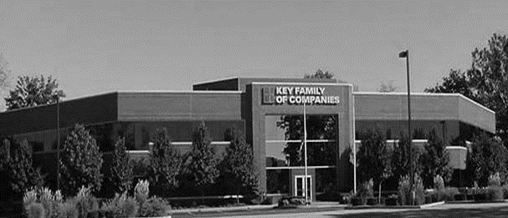



COLLABORATION OF STAKEHOLDERS
Key Benefit Administrators
Employer
Employee
Full TPA Administration
Stop-Loss Administration
True Transparency & Analytics
Population Health Management
Utilization & Case Management
Sales & Marketing
Transparent PBM
Website & Mobile App
Customizable options & plans
Incremental Revenues and Margin
Branding & Messaging
Benefit Plan Integration
Network Steerage
Direct Relationship with Self-Funded Employers
Referral Authorization
Plan Transparency
Direct Access to Members
Reduced Out of Pocket
Improved Health
Better Coordination & Navigation of Care
Direct Access to the Best Medical Providers
UCHealth’s DTE
Reduced Spend
“At The Table” with UCHealth
Improved Analytics
Complete Transparency
Lower Stop-Loss
Benefit Plan Stabilization
Healthier Population

Slide 42
ROLES & RESPONSIBILITIES
SERVICES & ADMINISTRATIVE SYSTEMS PROVIDED BY:
UCHealth | KBA Operations
Tier 1 Provider Network Provider Recruitment – If Necessary Network Pricing & Contract Terms Referral Management Protocols & Approvals Medical Director Oversight Practice Improvement Program using KBA/AHDI Data with Assistance from KBA | Network Evaluation – Actuarial Pricing PPO Wrap & Tertiary Transplant Network, if needed Claims Administration Plan Design Development, Testing, and Administration Employer/Member/Provider Customer Service Customized Member/Provider/Agent/HR Portal Billing, Enrollment (Electronic/Paper), and Premium Management Fulfilment – SPD & Customized ID Cards COBRA/HIPAA Administration Out of Network Negotiations Wrap PPO Repricing Nurse Coaching for Chronically Ill Nurse Triage to Physicians and Facilities Stop-Loss Underwriting, Pricing, and Placement Stop Loss Claims Administration Complex Case Management PBM Administration Interface Reporting Utilization & Gaps in Care Clinically Based Physician Profiling Referrals Chronic Disease Management Employer Health Risk Management Reports Ancillary Administration – Dental, Vision, Weekly Income, 5500, Life, etc. Health Savings Account (HSA), Flexible Spending (FSA), Health Reimbursement Account (HRA) Administration Sales & Marketing Plan Strategy Development: Branding, Brochures, Web Site Distribution System Development Sales Management
KBA Consulting
Program oversight and integration across the enterprise Goal development, agreement and tracking Start-up assessments: market, network, operational and readiness Draft business plan with financial projections Facilitate program communication and engagement with UCHealth departments including system c-suite, operations, HR, managed care, marketing, strategy and business development

Slide 43

PRE-IMPLEMENTATION
PROVIDER FILE
PRICING
Determine Gaps in Medical Service Delivery
Identify Other Key Providers to Potentially Contract with on Behalf of UCHealth
Wrap Network to Cover All Other Provider Types
To Dial in Competitive Stop-Loss Rates and UCHealth’s Net Revenues/Margins
Actuarial Evaluation Compared to the Market

Slide 44
IMPLEMENTATION
MONTH 1
Agreement & Project Scope
MONTH 1-6
Implementation
Market Outreach begins in Month 3
MONTH 3-6
Sales & Mkg.
Hire Sales Executive
MONTH 6 TO 8
GO LIVE!!

Slide 45





A Partner You Can Trust
OUR OBJECTIVES ARE ALIGNED
WE KNOW THE
MARKET
COMPLETELY TRANSPARENT
WE HAVE THE SOPHISTICATION AND INFRASTRUCTURE TO EFFECTIVELY COMPETE
Derek Moore, Senior Vice President – KBA
845-283-9973 * derek.moore@keybenefit.com

